Slide 1
VSMUG – 2020-06
David James
Director of Engineering
Microsoft
@djammmer
Virtual System Management User Group
Website: https://vsmug.com/
Content: https://vsmug.com/github
Twitter: @V_SMUG
YouTube: https://vsmug.com/youtube

Slide 2
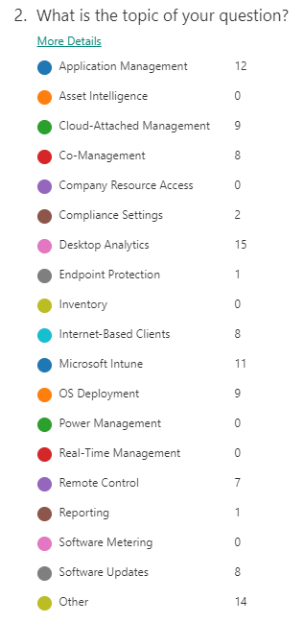

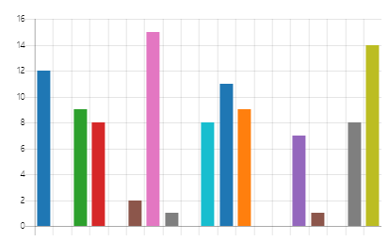
Questions - Overview

Slide 3

Question
So what is the difference between "Microsoft Endpoint Management Configuration Manager (MEMCM)" and "Microsoft Endpoint Configuration Manager (MECM)" ??? Bit of a marketing nightmare and I don't know what to use within my organization.

Slide 4
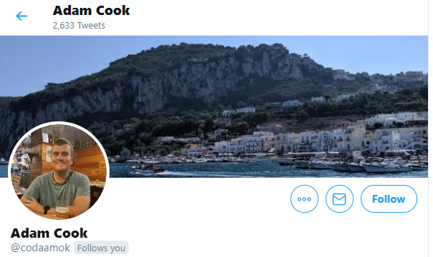
Question
Why should I cloud attach my environment right now? - Adam Cook
The connection between ConfigMgr and Intune is only getting deeper and deeper, the tenant attach seems like a stellar addition. Can you tell us something about what we might expect further down the road regarding these integrations? - Robert Koivumaa

Slide 5
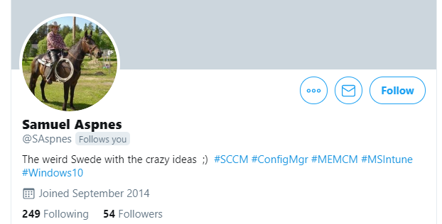
Question
Now that you and the team are facing the same #WFH scenario as everybody else, has it been faster and easier to test, develop and troubleshot new WFH functionality? Any new idéas?

Slide 6

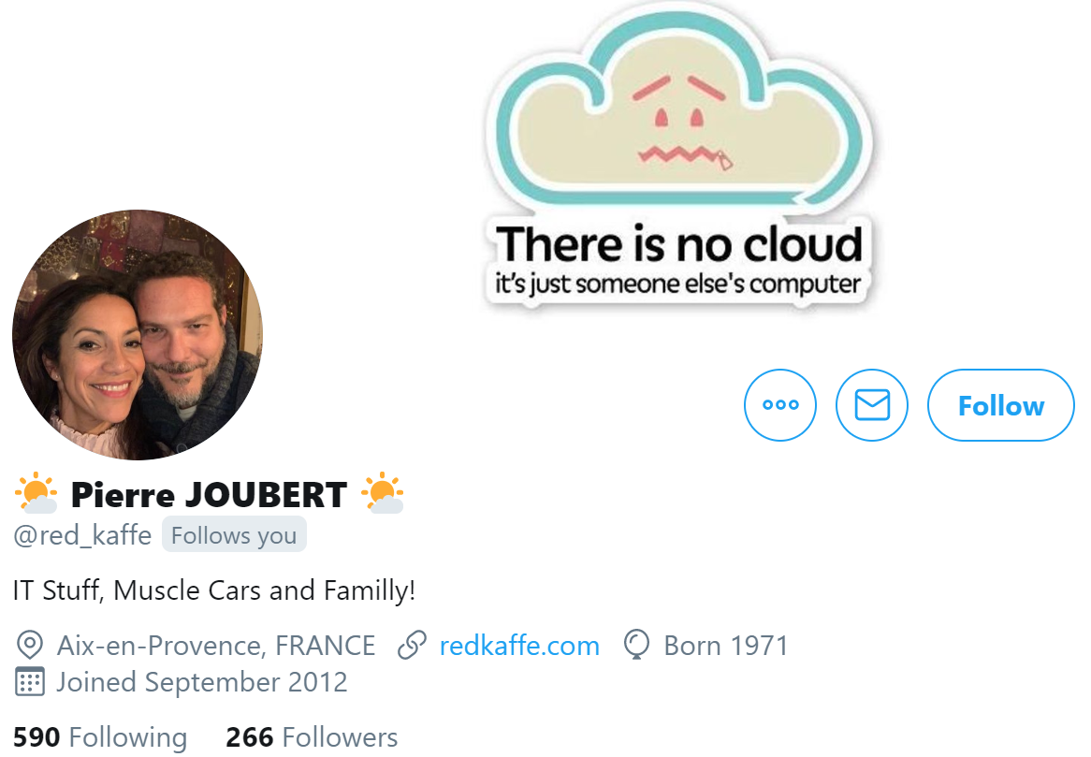
Question
How close is the ConfigMgr team to getting Remote Control over CMG working?
Will we see Remote Control or QuickAssist working over BGB or a proxy server soon? - Jeff Jerousek
Will it be possible to get remote control over the Microsoft Endpoint Manager admin center? - Marcelo
Are there any plans to expand on the capabilities of the MECM remote control? - Patrick Larson
Apart from TeamViewer integration, are there any plans to add a build in remote control tool like quick assist directly into Intune? This seems like a must have in any remote management tool...having a basic remote control tool into Intune would greatly improve the single console to rule them all feeling... - @red_kaffe

Slide 7
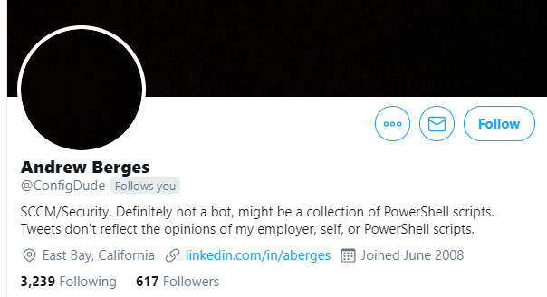
Question
When Desktop Analytics was first announced at Ignite last year, I was extremely psyched for its release because I was already leveraging Windows Analytics and was particularly impressed (as was my management) with the Device Health feature. I was very disappointed when I activated Desktop Analytics to see there was no longer such a feature.
Are there any plans to bring back this level of detailed telemetry regarding app crashes, etc? If so, is there an ETA? If not, WHY? :-) – Andrew

Slide 8
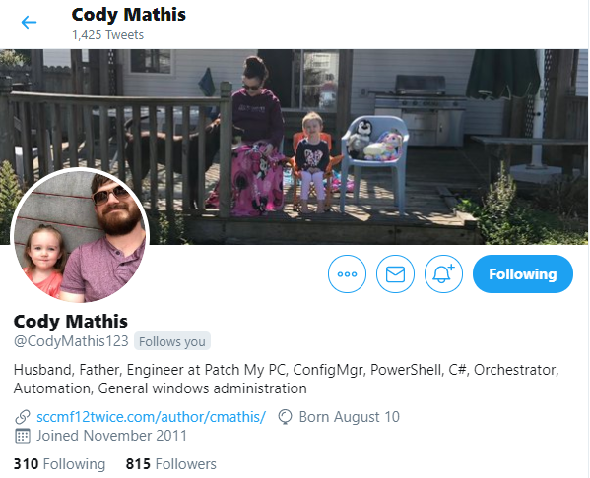
Question
When will HA be active/active will this require getting rid of inboxes?

Slide 9

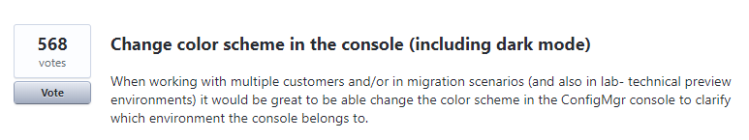
Question
I'm sure this question is asked a lot, but can the MECM Console get a proper Dark Mode? Spending all day working out of that console causes me severe eye fatigue because it is so much white! Thanks! - Casey
https://configurationmanager.uservoice.com/forums/300492-ideas/suggestions/35335000-change-color-scheme-in-the-console-including-dark

Slide 10
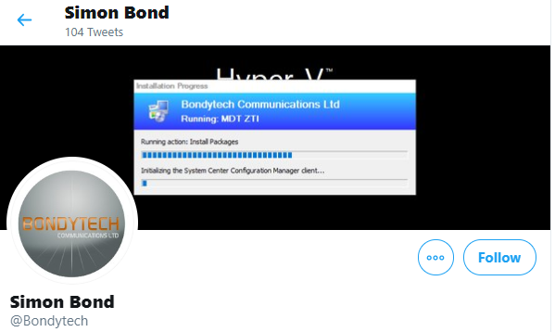
Question
Have you ever considered adding a 'Universal Search' facility in MEM? Just a plain-text bar you can search for IDs, names, whatever and MEM will find that object for you. Wildcards should be allowed. It'd be a winner.

Slide 11

Question
Is it possible to do multi-select for deletions on AppModel deployments versus having to select one at a time currently?
https://configurationmanager.uservoice.com/forums/300492-ideas/suggestions/16287157-delete-multiple-objects-from-console

Slide 12
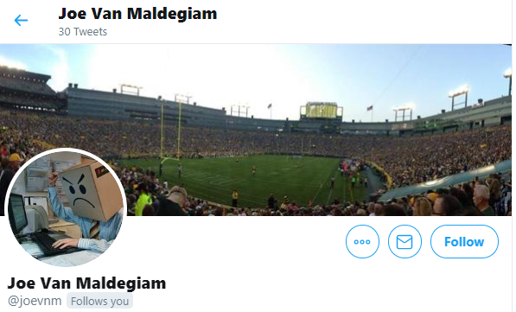
Question
We were using Desktop Analytics for bluescreen information and we wanted to use it as more of a holistic end user device experience product. Recently some of the features of DA have been deprecated and it's no longer a solution for what we were trying to accomplish. Is there any other platform/product we could use to gather that information? We were thinking of trying to get these high-level data points: - Blue screens (and cause if possible) - Application crashes - Bluescreens based on driver versions across our fleet - How long a login takes - 802.1X authentication issues (for corporate network)

Slide 13

Question
As more companies are pushing towards Intune only over SCCM and Intune co-mgmt how can we ensure that the 3rd party apps can be kept up to date in a similar way that SCCM can do when using Patch My PC
– Mark Edwards & Paul

Slide 14
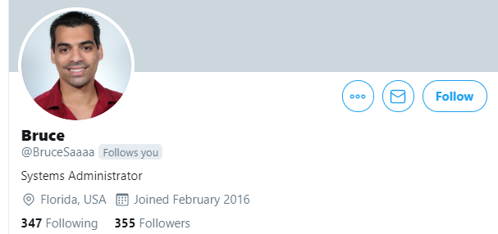
Question
- When will LAPS be available in Intune/Azure? - How about 0day patching with Intune?
https://microsoftintune.uservoice.com/forums/291681-ideas/suggestions/34248085-add-laps-support-into-intune

Slide 15
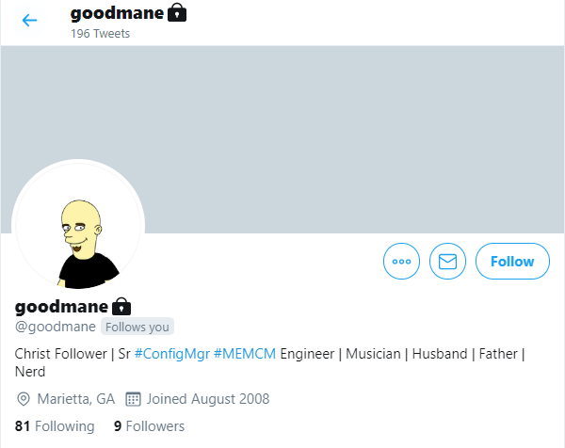
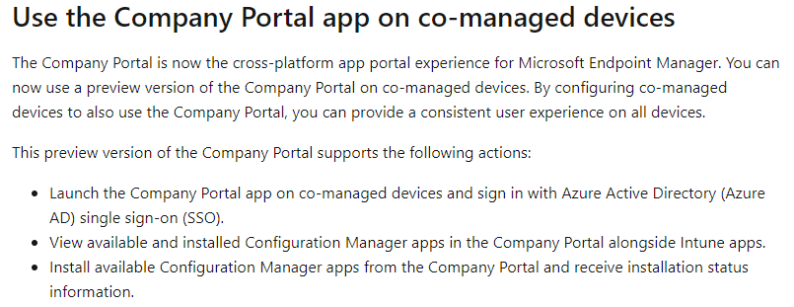
Question
Hi! Are there any plans to merge the Company Portal & Software Center (maybe the Windows Store too) In a co-managed scenario it can be very confusing for users on where to find their various apps if they have to go to different portals. Thanks!
ConfigMgr 2006

Slide 16

Question
As CM-Pivot become more robust and more functionality is built in, is there a look toward the future to have it replace reporting in sccm?

Slide 17
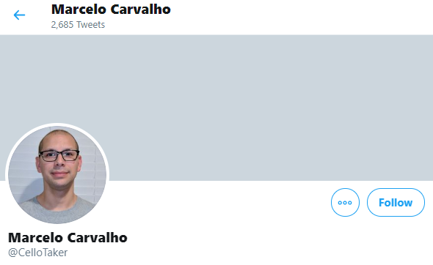
Question
Will there be support for Chromebooks in Intune?

Slide 18
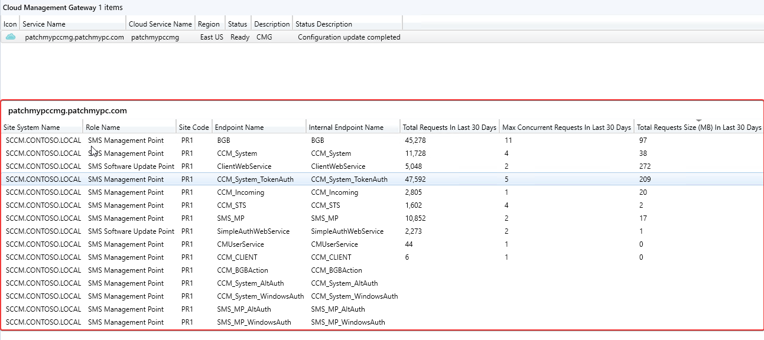
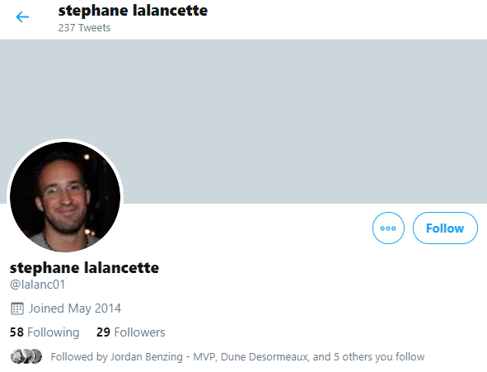
Question
Hi, is there a way to know what data (size and type, like hardware inventory, SU scans) was sent via the CMG to on-premise sccm infra? I'm asking because for about 36hours since we started using the CMG, we have used about 10gigs of outbound data (no packages) for about 200 clients which averages at 30mb per day per client (1gigs per month) which is way higher than what the doc says (300mb) we might see for an aggressive client configuration. I know all configs are different, so that is why I want to understand why it's so high. Thks in advance and don,t hesitate if you have any questions.

Slide 19
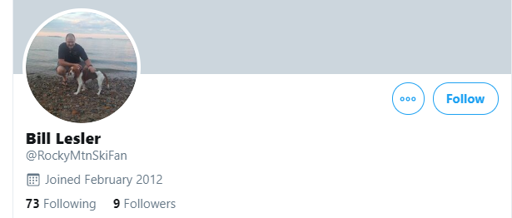
Question
Is there a way to deploy the MECM client to an internet based client?
https://setupconfigmgr.com/how-to-setup-cloud-management-gateway-cmg-in-microsoft-sccm
https://setupconfigmgr.com/token-based-authentication-for-cloud-management-gateway-in-configuration-manager
https://setupconfigmgr.com/token-based-authentication-for-cloud-management-gateway-in-configuration-manager

Slide 20
Question
It doesn't look as though you can deploy applications to user collections over the CMG if the devices aren't at least hybrid AD joined. Is that correct? If not how can we get better documentation around what is required to get this setup properly?
- Johan

Slide 21

Question
from: https://docs.microsoft.com/en-us/mem/configmgr/sum/deploy-use/optimize-windows-10-update-delivery#bkmk_DO-1910 When using a CMG for content storage, the content for third-party updates won't download to clients if the Download delta content when available client setting is enabled. Is it going to be fixed in future versions? We would like to benefit from DO and not to loose opportunity to deploy 3rd party Updates.
https://patchmypc.com/third-party-updates-fail-to-download-in-configmgr-1910-if-download-delta-update-enabled-and-client-is-using-cloud-management-gateway-cmg-0x80d02002

Slide 22
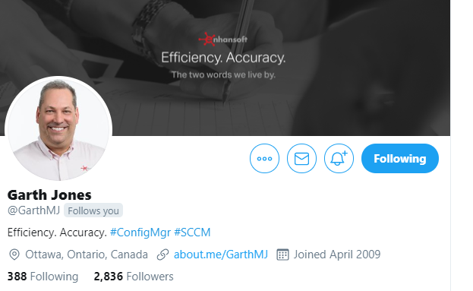
Question
Is there a way to remove custom DDRs from ConfigMgr?

Slide 23

Question
As the WFH culture is booming, I would like to ask about Possibilities of installing OS via bare-metal through Internet Gateway. Sorry if it's already in pipeline. If it's already, when can we expect this in PROD? - @ranjithckm7
How far off are we being able to offer rebuilds via cmg to people at home on their own Broadband/fibre. And not having to contact the onprem management point? Ta - Snoop Watty Watt

Slide 24
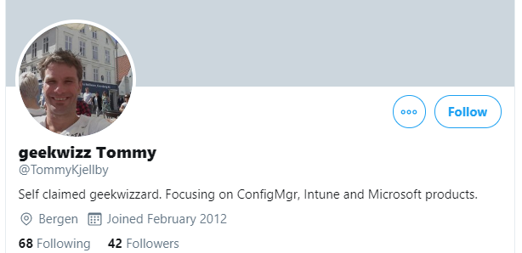
Question
Your team are doing great work. But there are some very good applications like
Donna Ryan´s Wim Witch
David Segura´s OSDBuilder/Update/drivers
Maurice Daly´s Driver Automation Tool
onevinn´s Windows 10 Upgrade Tools
Martin Bengtsson´s Toast Notification and many more.
Are your team testing this applications ? and do you consider to adopt functionality from these applications? or hire them, so they can work to incorporate this into MEMCM?

Slide 25
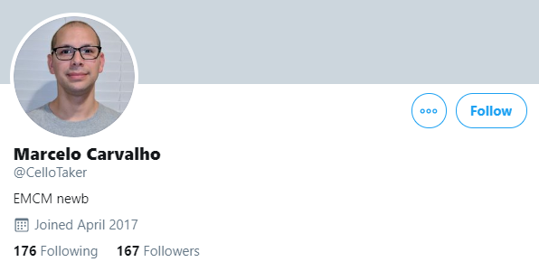
Question
Will it be possible to get remote control over the Microsoft Endpoint Manager admin center (Intune)?

Slide 26
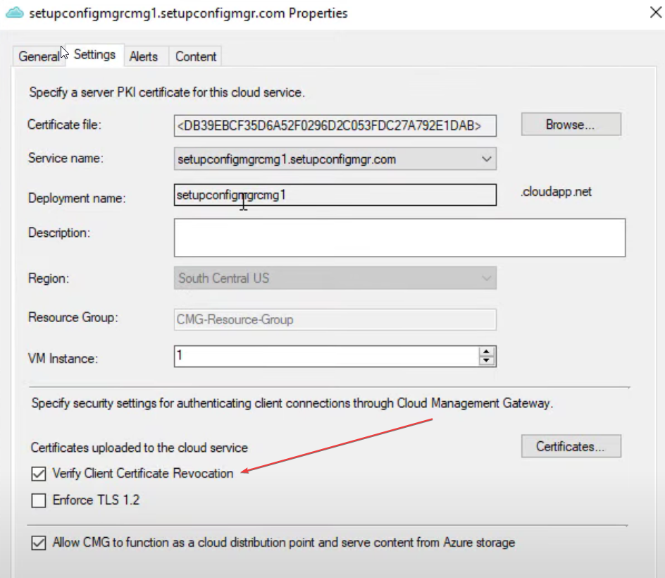
Question
Currently have an internal PKI SCCM env, is co-management possible in this situation without a publicly accessible CRL? having issues pushing ConfigMgr client to internet only clients. - Rob
https://youtu.be/8jPYAuOgjD0?t=1265

Slide 27

Question
Is there a way to speed up the sync between MECM and Desktop Analytics? Waiting a couple of days for changes to replicate is... lets just say, rough.

Slide 28

Question
What can we be doing to ensure the health of our CM Agents stays good/working? This is especially more important as devices are been taken off premises?

Slide 29

Question
Multiple MEMCM hierarchies are supported within Desktop Analytics, but multiple workspaces inside one Azure tenant are still not possible. Any roadmap on this evolving?

Slide 30
Question
With the proliferation of apps/SaaS apps installing with user rights into the user profile (Zoom, WebEx, Teams, etc), MEMCM Hardware Inventory has no lens into this data. Software Inventory of every EXE in the user profile is a less than elegant solution. Are there any plans for MEMCM to expand inventory capabilities into the user profile? - Tim Nelson
With the increasing frequency of user profile installed applications (i.e. Zoom, and the like when user initiated), is there any plan to better query and manipulate user profiles? – Adam M.

Slide 31
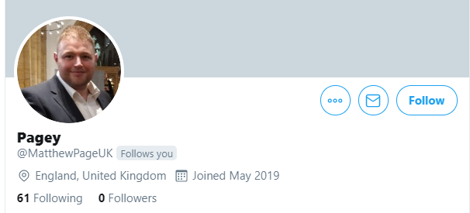
Question
We currently use MECM for all our workloads and nothing in Intune. All of our users use AlwaysOnVPN when onsite and working remotely. We are keen to stay relevant, but is there any specific reason/benefit we should look to use InTune?
Currently, GPO's/ConfigMgr/VPN does everything we want, so wanted to understand what benefits/improvements we would get if we put in the leg work to move some workloads to Intune? Thanks, and we really appreciate the regular updates and new functions you and your team bring to the products.

Slide 32

Question
Why SMS_CLOUD_PROXYCONNECTOR (CMG Connection Point) component is not available under Monitoring->System Status - Component status in console? How should we monitor that it is operating normally?

Slide 33
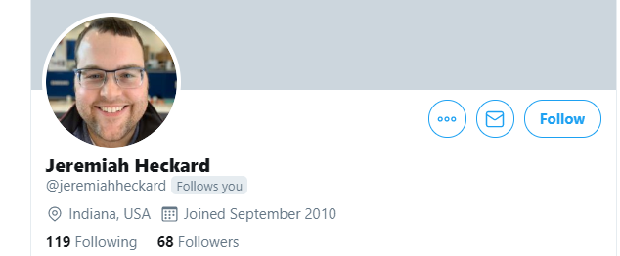
Question
How do you recommend deploying and managing co-management in a ConfigMan environment that contains a mixture of servers, vm's, workstations, and machines that use service accounts? For now, we just have our pilot group set to the machines that we are targeting for co-management. Do we leave it like this long term?

Slide 34
Question
Is there a Quick and efficient way to get something up and running with reporting/desktop analytics with stand alone Intune? I used to have Sccm and we had upgrade readiness, I can’t seem to find any equivalent easy to setup solution for Intune / win10 in stand alone mode.

Slide 35
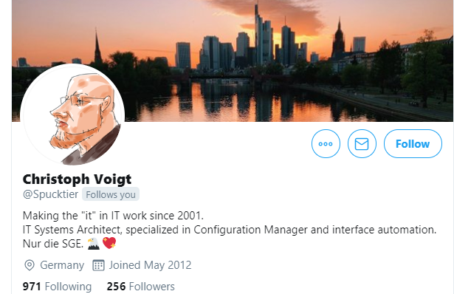
Question
A major pain point for operating ConfigMgr infrastructure in highly secure networks or Tiered environments is the historically spotty implementation of proxy use and run as capabilities of the console.
Uservoice has several items in regard to proxy server usage in the console but it does not seem to be on the radar for the product team to simplify/unify the use of proxy servers in the console.
Can you elaborate why?(Pain points: some components use the IE proxy config, some use the Software Update proxy, some components seem to use embedded IE (Community -> Documentation), some require Edge (Community -> Hub) and no console components like Community Documentation don't respect HTTP 407 (Proxy Authentication Required) to prompt for proxy credentials)"

Slide 36
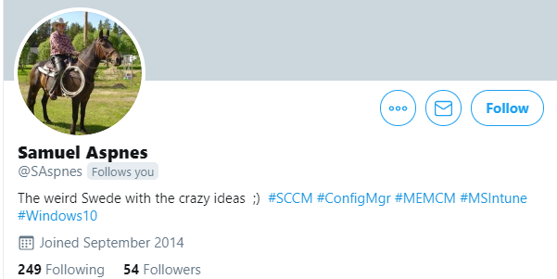
Question
Will there be a lightweight/hybrid console or are you going to keep adding new functions to Microsoft Endpoint Manager Admin Center until we get a fully revamped legacy console and they blend together?

Slide 37

Question
What is the best solution to manage remote endpoints in terms of VPN connections and software updates and feature updates? and depending in the previous question, what would be the recommendation for feature updates, a task sequence o a windows update? I was told by network team that VPN split tunnel is considered a security risk, is that true?

Slide 38
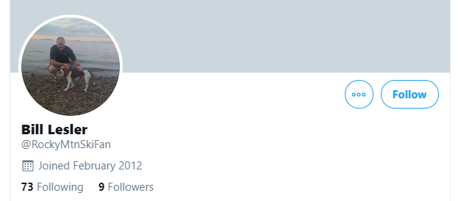
Question
Is there a way for BitLocker enabled Internet based client to communicated with an IBCM Recovery Service MP?

Slide 39
Question
Is it possible for Microsoft to exclude virtual clusters from SCCM discovery? This User Voice article suggests it is but outside of creating a separate OU, it doesn't appear to be possible. We would just like to exclude any virtual cluster objects detected natively as we want to get away from creating additional OU's https://configurationmanager.uservoice.com/forums/300492-ideas/suggestions/8414520-exclude-virtual-cluster-and-ou-from-discovery
- Jim Callaghan

Slide 40
Question
Currently Intune update ring reporting seems very basic compared to SCCM. Is there any plans to expand reporting within Intune to become extensive?
- Alex Summers

Slide 41
Question
How desktop analytics is going to change the game during windows 10 servicing with regards to non-compatible applications or drivers.
- Deepu Koul
Role of Desktop Analytics to validate application application compatibility with Windows
- Harsha K

Slide 43
Section Header
This is the next section

Slide 44
Title
Line1
Bullet Level 1
Bullet Level 2
Bullet Level 3

Slide 45
Title
Code

Slide 46
Text Only with Border
Level 1
Level 2
Level 3

Slide 47
Text Only (Red)
Level 1
Level 2
Level 3

Slide 48
Title
Text 1
Level 1
Level 2
Level 3
Text 2
Level 1
Level 2
Level 3

Slide 49
Title
Section 1
Section 2
Text
Level 1
Level 2
Level 3
Text
Level 1
Level 2
Level 3

Slide 50
Demo Title

Slide 51





























Slide 52






























Slide 53




























Slide 54




























Slide 55




























Slide 56




























Slide 57




























Slide 58























Slide 59
















